Slide 1
Bottlebrush Polymer & Surfactant Blends for Low IFT
Luqing Qi, Hadi ShamsiJazeyi, Xianyu Li, Stacy Pesek, Maura Puerto, Rafael Verduzco, George Hirasaki
Department of Chemical and Biomolecular Engineering
Rice University, Houston, TX, 77005

Slide 2
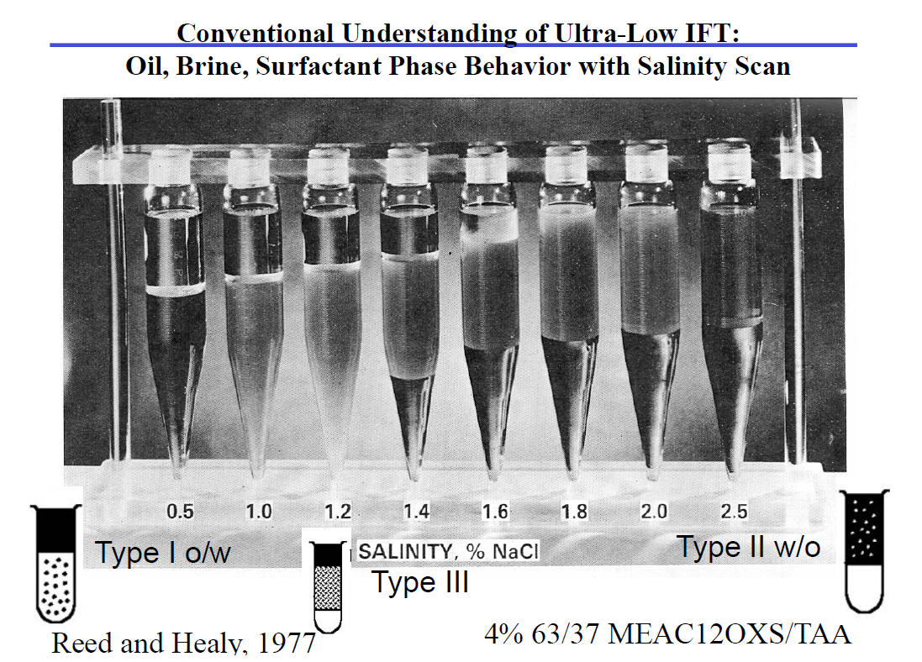
Background
The phase behavior of surfactant and surfactant blends can be analyzed through salinity scans
The phase behavior goes from Winsor Type I to Winsor TypeⅡwith the increase in salinity. A bicontinuous middle phase may result in ultralow interfacial tension (IFT) values

Slide 3
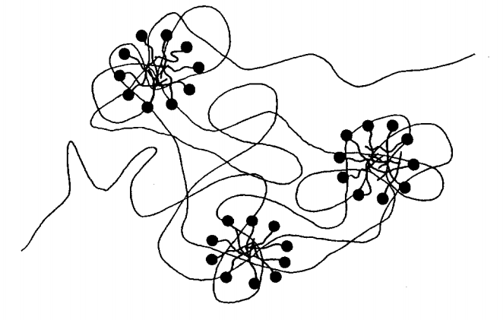
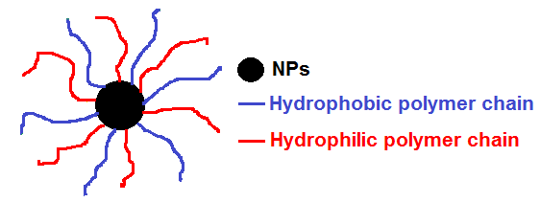
Polymer additives can influence phase behavior and micelle structure
Hydrophilic chain
R. Nagarajan, J. Chem. Phys. 90 (3), 1 February 1989
Hydrophobic chain
What will happen to phase behavior, interfacial tension(IFT) and CMC if we add polymers or polymer coated nanoparticles into this system?

Slide 4
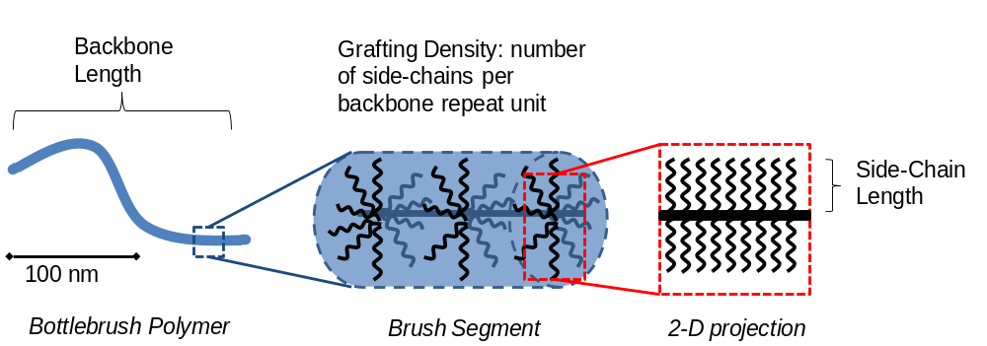
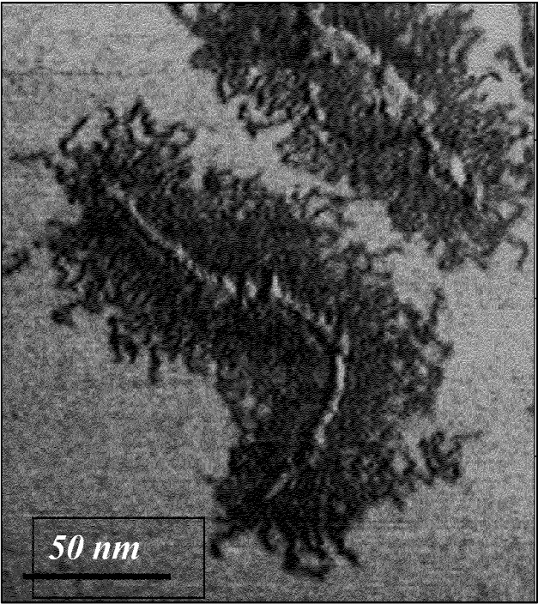
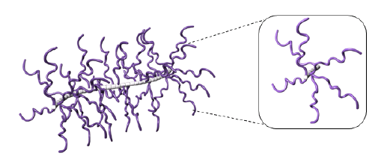
Bottlebrush polymers: densely grafted branched polymers
Matyjaszewski et al., Macromolecules 2001

Slide 5
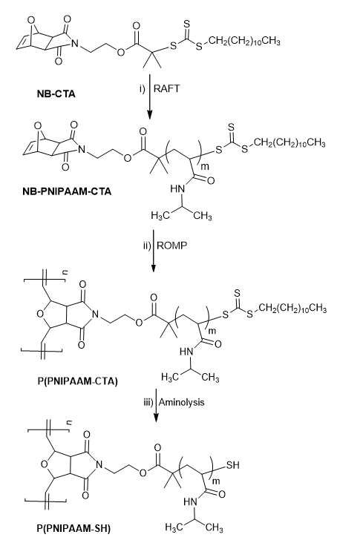
Synthesis of bottlebrush polymer
●Norbornenyl-chain transfer agent (NB-CTA)
● Reversible addition fragmentation chain-transfer (RAFT) synthesis of side-chain
● Ring-opening metathesis polymerization (ROMP) to make bottlebrush polymer
● Removal of terminal CTA through aminolysis
Provides control over bottlebrush side-chain and backbone length
Li, Verduzco et al., Soft Matter 2014, 10, 2008-2015.

Slide 6
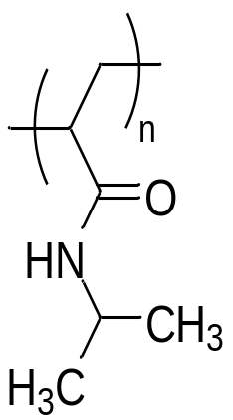
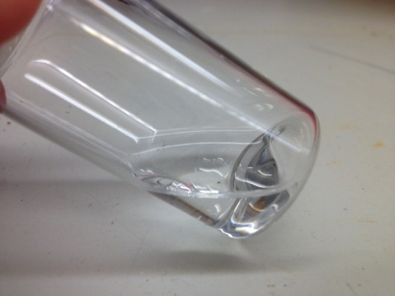
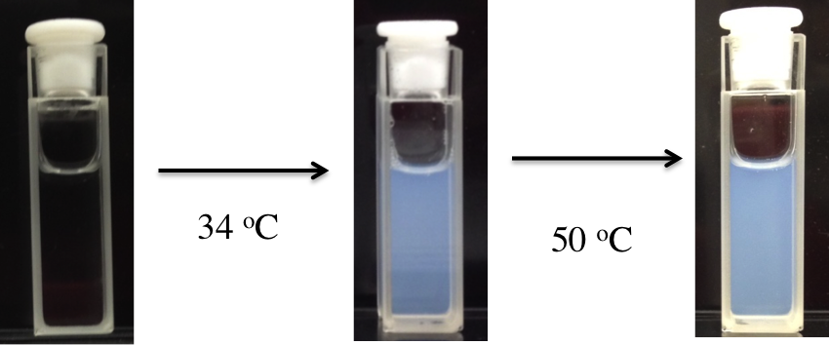
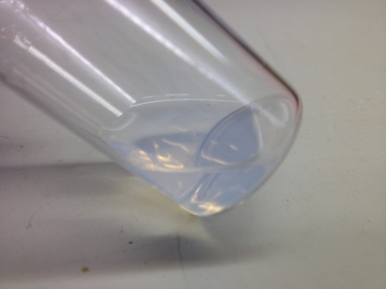
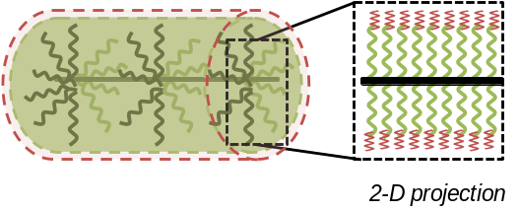
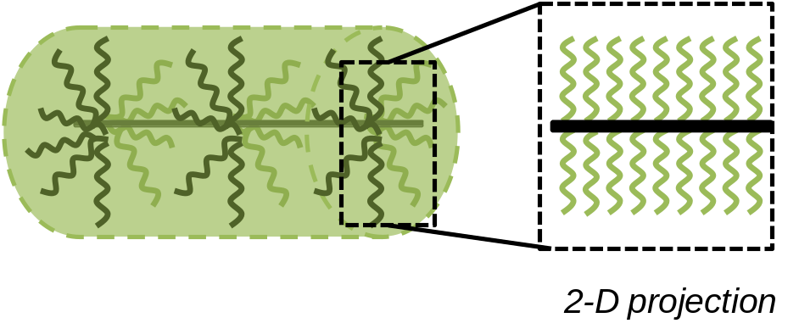
PNIPAAM is thermoresponsive and exhibits an LCST
T < 32ºC
T > 32ºC
PNIPAAM
PNIPAAM is water soluble at room temperature, insoluble above 32 ºC
with CTA
without CTA
PolyNIPAAM Bottlebrush Polymers exhibit an LCST near 32 ºC
Side-chain length | 4K | 5.6K | 9K
with CTA | 25.52°C | 29.75°C | 30.25°C
without CTA | 31.76°C | 34.25°C | 34.30°C
Notes:
PNIPAAM is water soluble at room temperature, insoluble above 32 oC

Slide 7
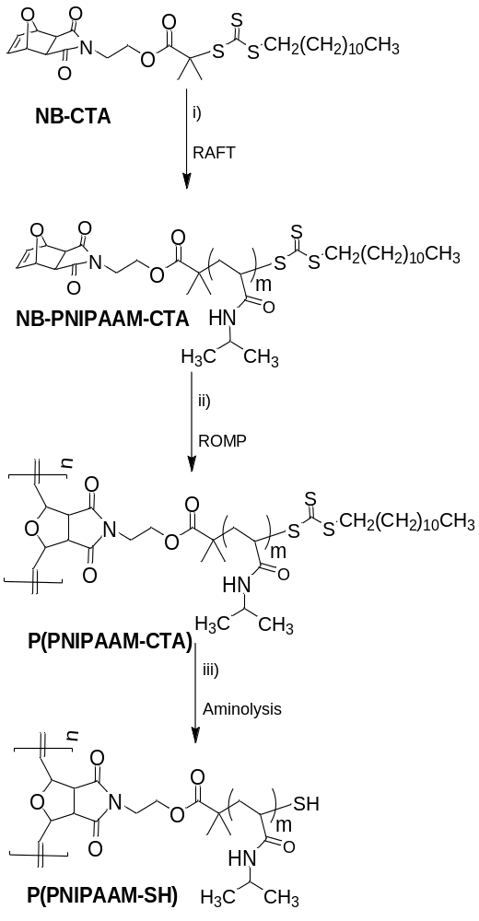
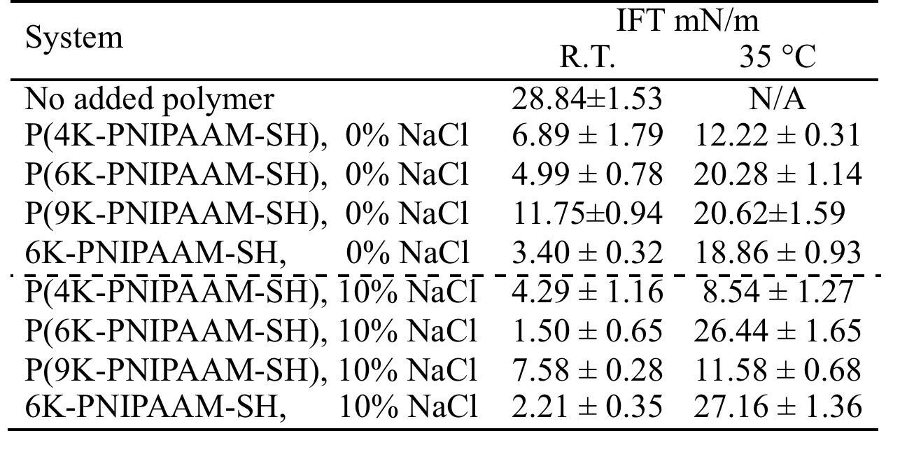
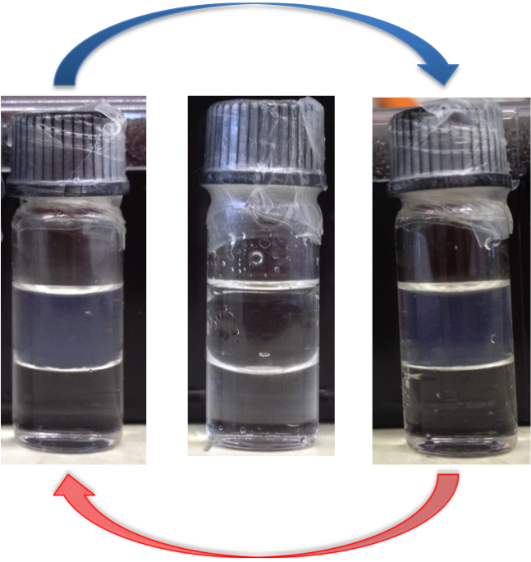
PNIPAAM bottlebrushes exhibit a modest decrease in oil/water IFT
PNIPAAM Bottlebrush polymer

Slide 8
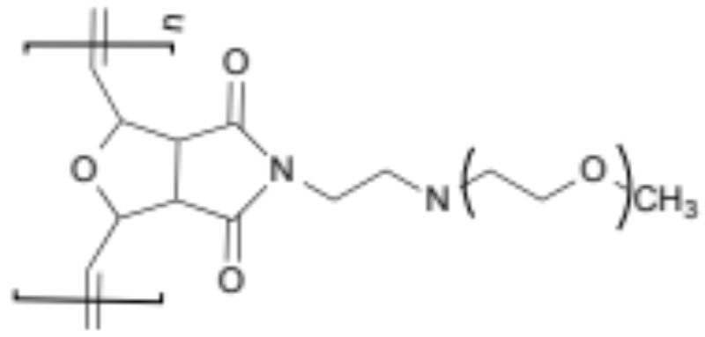
Bottlebrush Polymer
 | M_{W} (g/mol) |  | PDI |  | Side chain M_{W} (g/mol)
PNIPAAM bottlebrush | 2.8×10⁵ |  | 1.11 |  | 7000 (40 per bottlebrush)
PEG bottlebrush | 1.0 ×10⁶ |  | 1.28 |  | 5000 (200 per bottlebrush)
Poly(N-isopropyl acrylamide)
(PNIPAAM) bottlebrush
Poly(ethylene glycol)
(PEG) bottlebrush

Slide 9
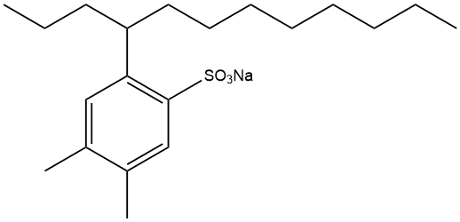
Analysis of surfactant/bottlebrush polymer blends
Analyze the phase behavior and oil-water interfacial tension of:
●OXS surfactant
●OXS surfactant and PNIPAAM bottlebrush polymer blend
●OXS surfactant and PEG bottlebrush polymer blend
Surfactant: C12 4,5 orthoxylene sulfonate(OXS)
PNIPAAM Bottlebrush polymer
Surfactant provided by ExxonMobil
Active sodium sulfonate 82.5%
Notes:
Exam pure surfactant, nb, blend compare ift phase behavior

Slide 10
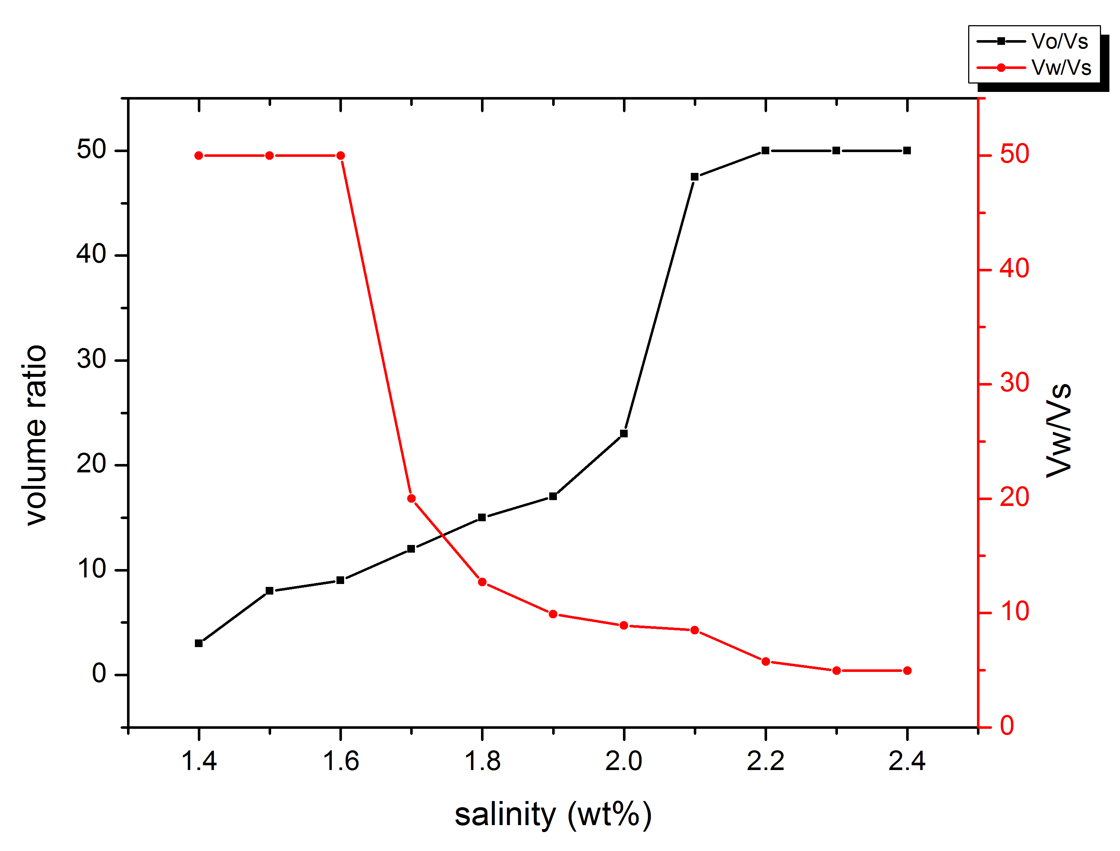
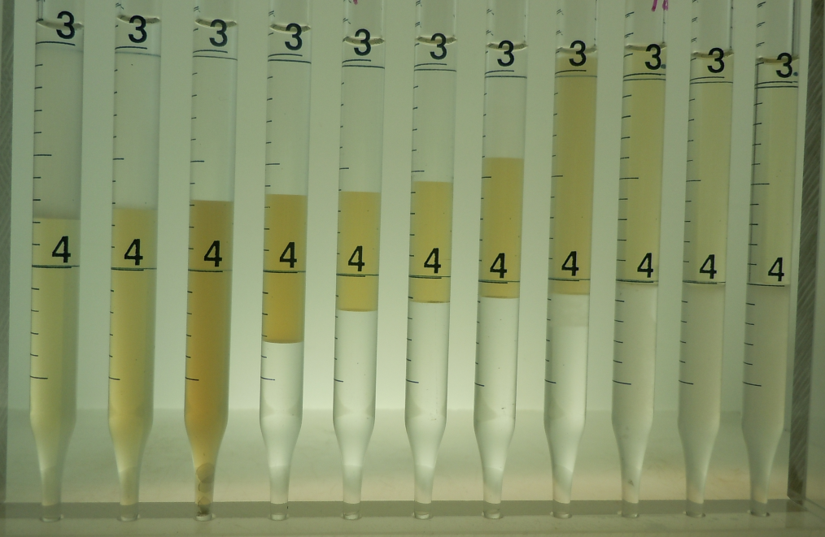
OXS Phase Behavior
Salinity scan of pure OXS
2% Surfactant, 2.5% alcohol, 1mL octane, 1.4%-2.4%NaCl
1.4 %
From salinity scan, the optimal salinity for pure OXS surfactant is around 1.7wt%
2.4 %
Optimal salinity around 1.7wt%

Slide 11
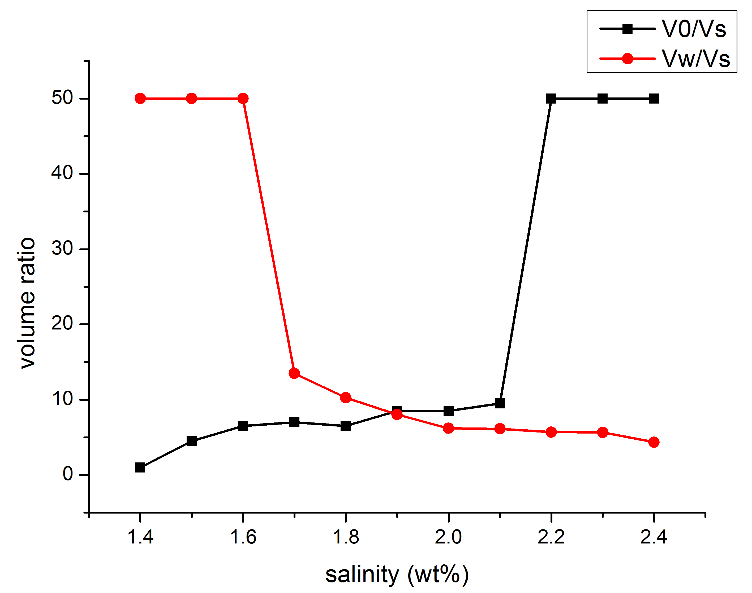
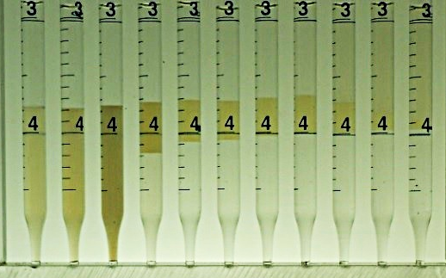
OXS + Bottlebrush phase behavior
Salinity scan of OXS surfactant-PNIPAM bottlebrush
2% Surfactant, 2.5% alcohol, 1mL octane, 0.1 % bottlebrush, 1.4%-2.4%NaCl
1.4 %
2.4 %
From salinity scan, the optimal salinity for pure OXS surfactant-PNIPAM bottlebrush blend is around 1.7wt%
Optimal salinity around 1.9wt%

Slide 12
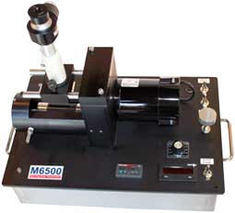
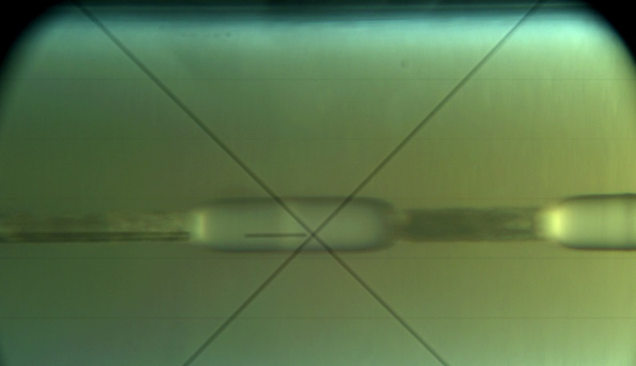
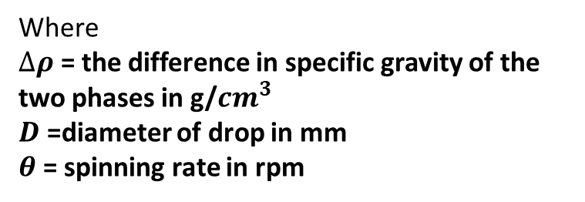

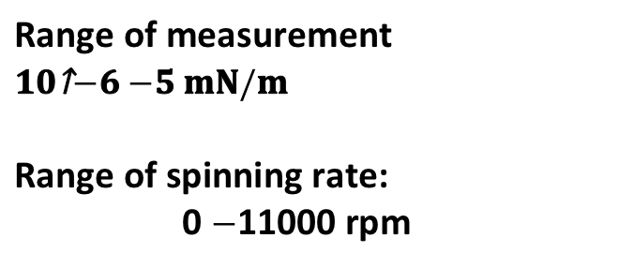
Interfacial Tension (IFT) Measurement
IFT measurement is done through spinning drop tensiometer (Grace Instruments M6500)
Range of measurement
$${10}^{−6}−5 mN/m$$
Range of spinning rate:
0 $−$11000 rpm
$$γ=1.44×{10}^{−7}(∆ρ)(D^{3})(θ^{2})$$
Where
$∆ρ$ = the difference in specific gravity of the two phases in g/${cm}^{3}$
$D$ =diameter of drop in mm
$θ$ = spinning rate in rpm
Stationary
phase
Mobile
phase
Notes:
10-6

Slide 13
IFT Comparison Shows Synergistic Interaction
System | NaCl concentration | IFT (mN/m)
Pure surfactant | 1.4 % 1.7 % (optimal) | 2.23×10⁻² 2.76×10⁻²
 | 2.0 % | 5.46×10⁻²
Surfactant + 0.1 % PNIPAAM Bottlebrush | 1.4 % | 3.67×10⁻²
 | 1.5 % 1.9% (optimal) | 5.46×10⁻² 7.52×10⁻³
 | 2.0 % | 2.78×10⁻⁴
Surfactant + 0.1 % PEG Bottlebrush | 1.4 % | 4.69×10⁻²
 | 2.0 % | 3.78×10⁻⁴
At optimal salinity, measurements were sampled from upper and lower phases. All other measurements were sampled from microemulsion.
Notes:
Add optimal salinity here specify upper phase

Slide 14
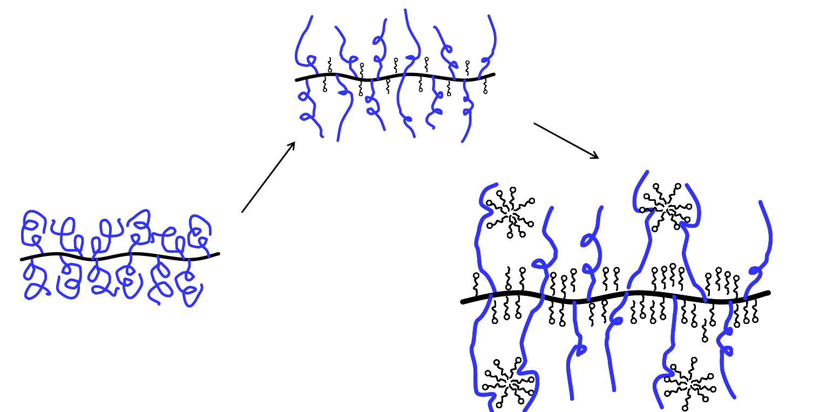
Hypothesis: surfactant/polymer associations
Associations between polymer and surfactant result in a shift in the phase behavior and decrease in the IFT
Associations can increase the CMC
Notes:
General , affect CMC

Slide 15
Conclusions: Bottlerush- Surfactant Hybrids
  ●Bottlebrush polymers give only a modest reduction in oil/water IFT.
  ●Blends of bottlebrush polymers with surfactant result in significant changes to the surfactant phase behavior and a decrease in the IFT at optimal salinities
  ●Small amount of bottlebrush polymer additive (0.1wt %) produces significant reductions in IFT
Notes:
15

Slide 16
  Future Work
  Measure the critical micelle concentration (CMC) of bottlebrush/surfactant blends
  Characterize surfactant-bottlebrush associations through dynamic light scattering, X-ray scattering, and electron microscopy
  Analyze the rheological properties of bottlebrush polymer/surfactant blends

Slide 17
The authors acknowledge the financial support from Rice University Consortium for Processes in Porous Media
Thanks for your attention!
Question?

Slide 18
Backup slides

Slide 19
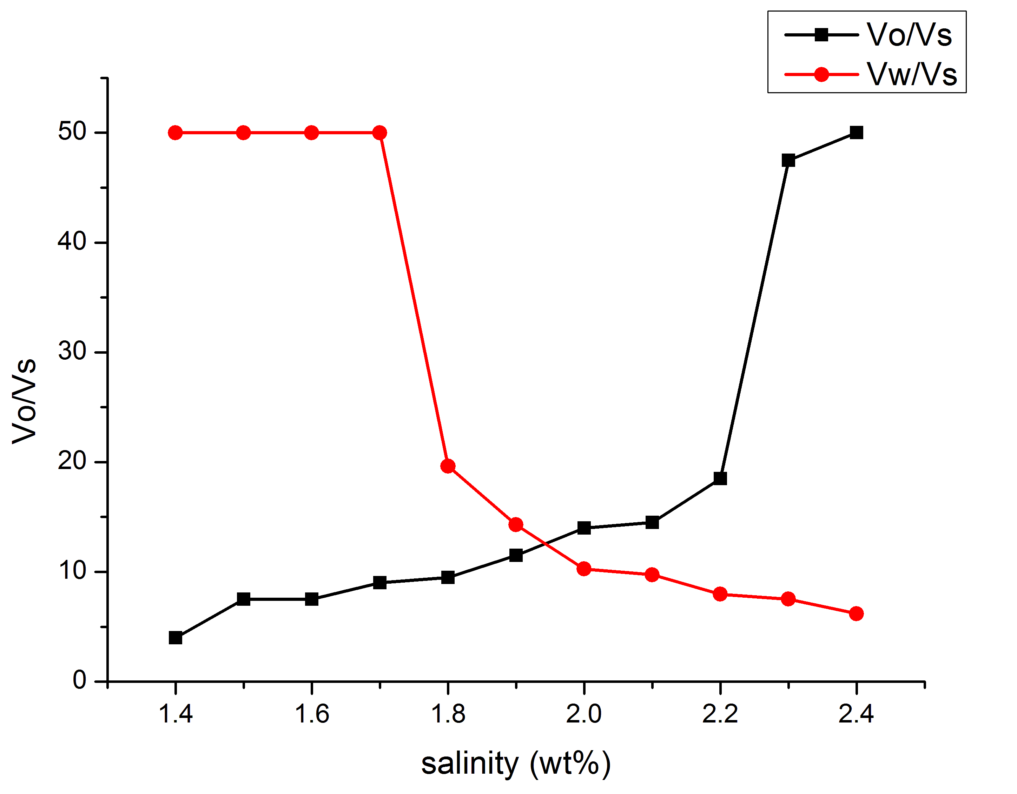
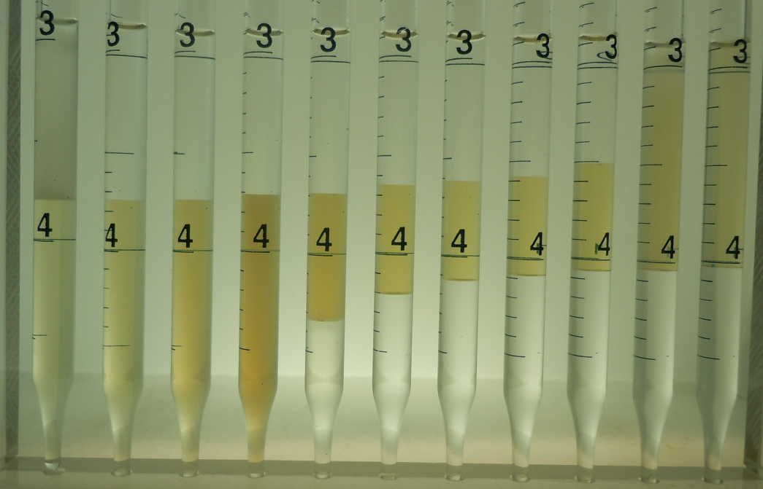
OXS + linear PNIPAAM phase behavior
Salinity scan of OXS surfactant-PNIPAM linear polymer
2% Surfactant, 2.5% alcohol, 1mL octane, 0.1 % polymer, 1.4%-2.0%NaCl
1.4 %
2.4 %
From salinity scan, the optimal salinity for pure OXS surfactant-PNIPAM linear macromonomer blend is around 1.7wt%
Optimal salinity over 1.9wt%

